Slide 1
CUSTOMER CHURN PREDICTION & Risk Analytics
ML - MINIPROJECT - 2
BY:
EZHILARASI K
TEAM - 1

Slide 2
Introduction
Predicts whether a customer is likely to churn or stay
Uses Machine Learning classification techniques
Compares 4 different ML models
Identifies customers with high churn risk
Analyzes important factors influencing churn
Provides an interactive Streamlit prediction website

Slide 3
Objectives
Perform data preprocessing and feature engineering
Train 4 ML classification models
Evaluate models using Accuracy, Precision, Recall, F1 & ROC-AUC
Compare models and select the best-performing model
Predict individual customer churn probability
Provide retention recommendations for high-risk customers

Slide 4
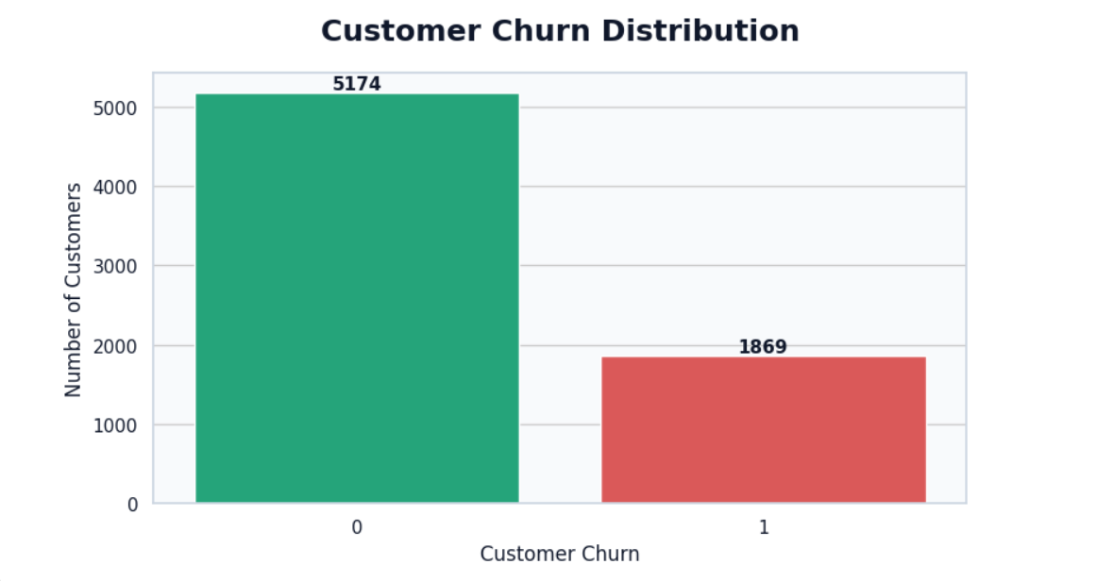
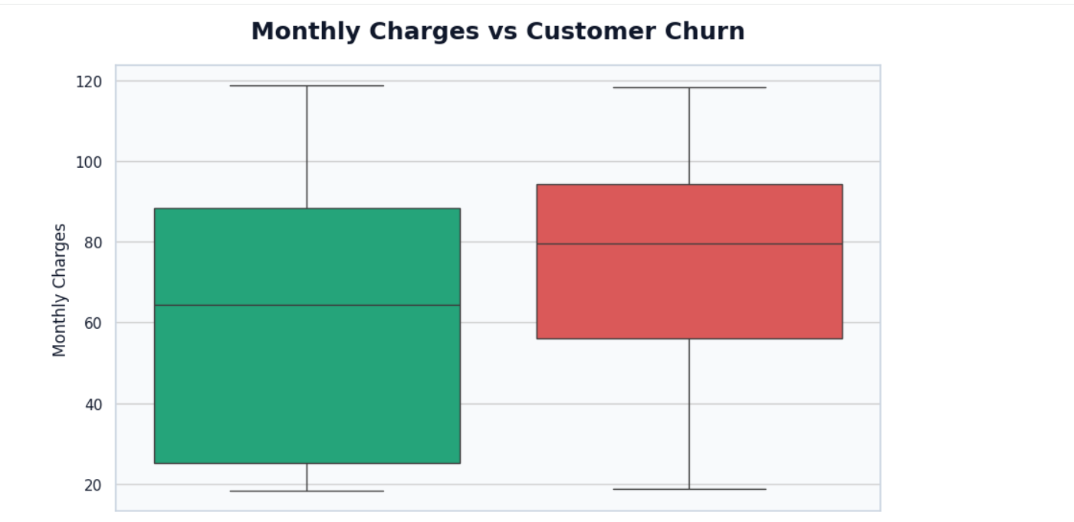
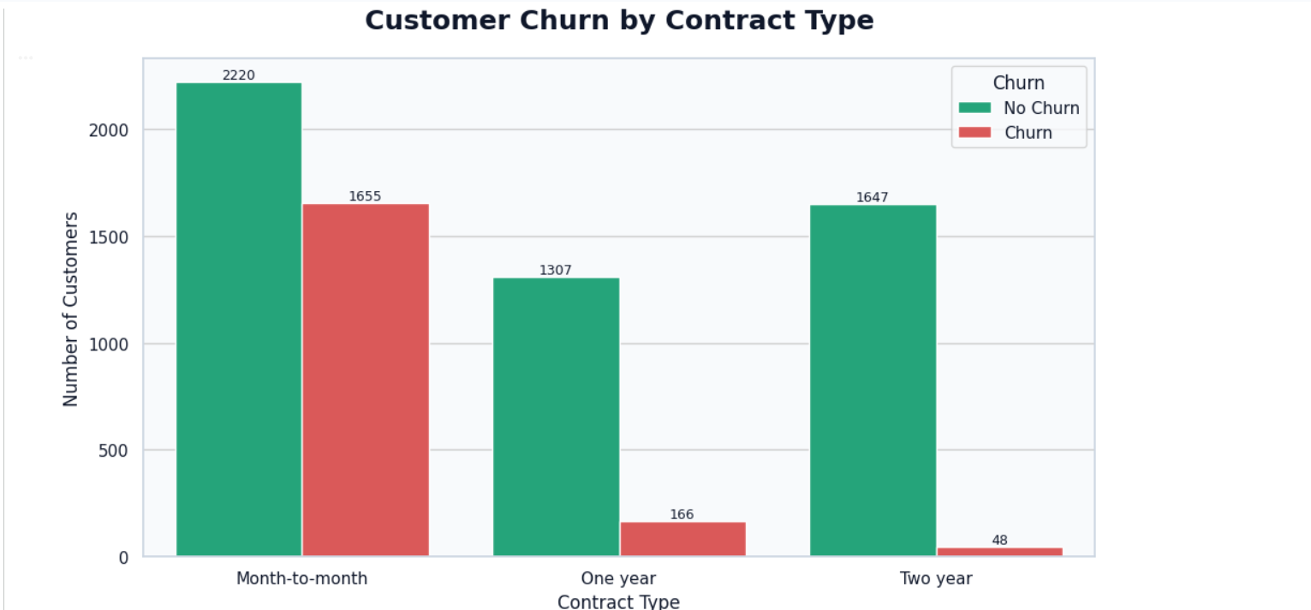
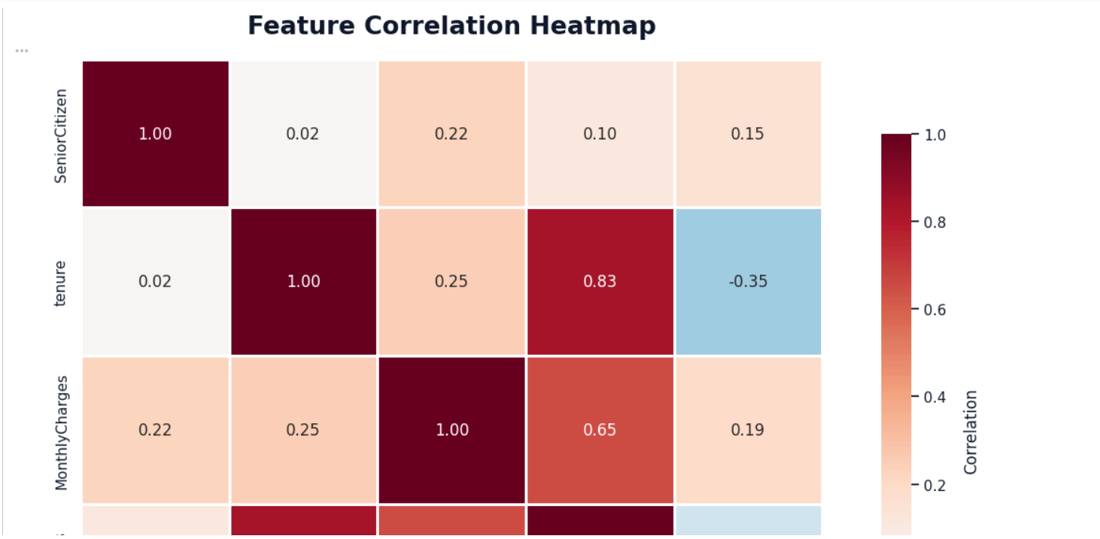
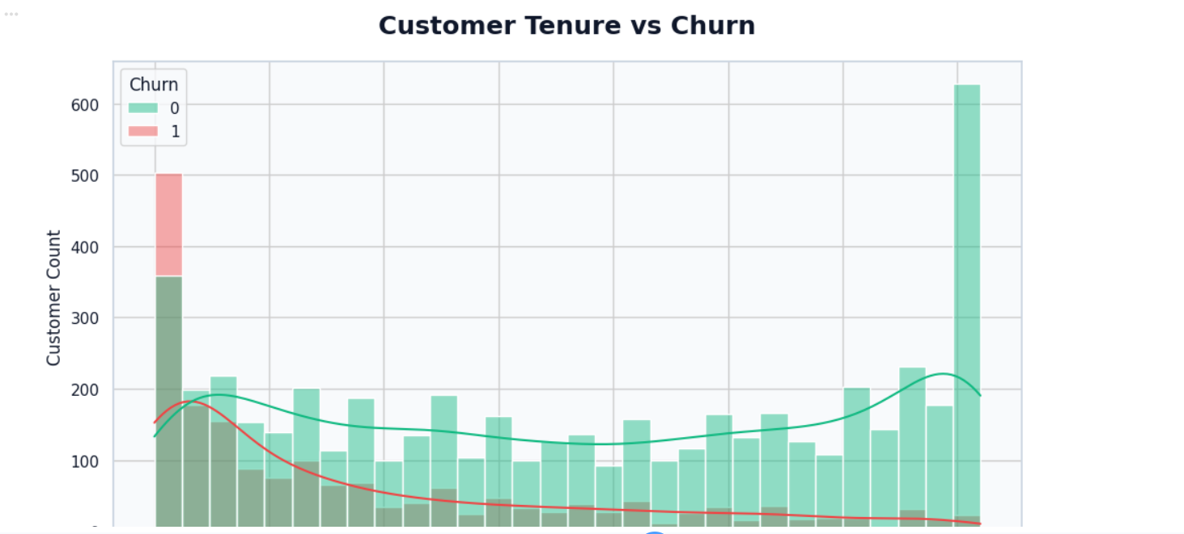
Data Analysis & Visualization
1.Churn Distribution
Shows the proportion of customers who churned versus those who remained, helping understand the target-class distribution.
2. Contract vs Churn
Shows how churn varies across different contract types and helps identify contract categories with higher customer attrition.
3. Tenure vs Churn
Shows the relationship between customer tenure and churn, helping identify whether newer or long-term customers are more likely to leave.
4. Monthly Charges vs Churn
Compares monthly charges between churned and retained customers to identify potential pricing-related churn patterns.
5. Correlation Heatmap
Displays relationships between numerical features and helps identify variables that may have stronger associations with customer churn.

Slide 5
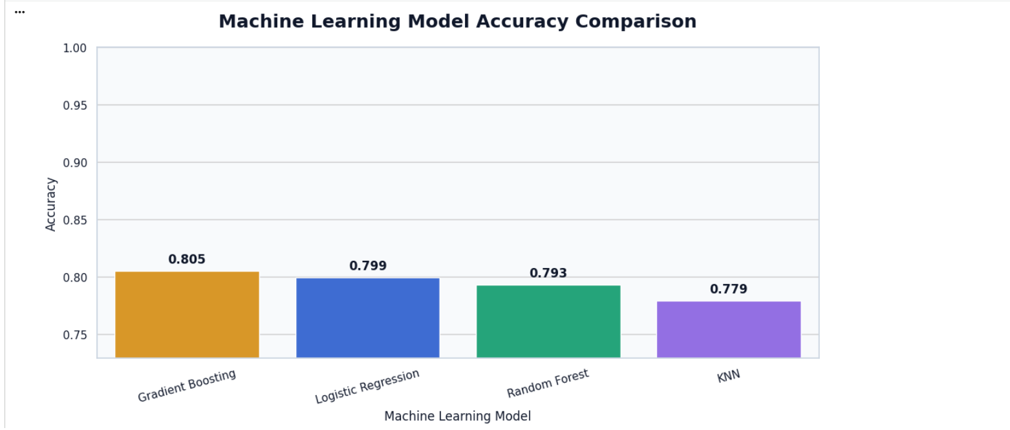
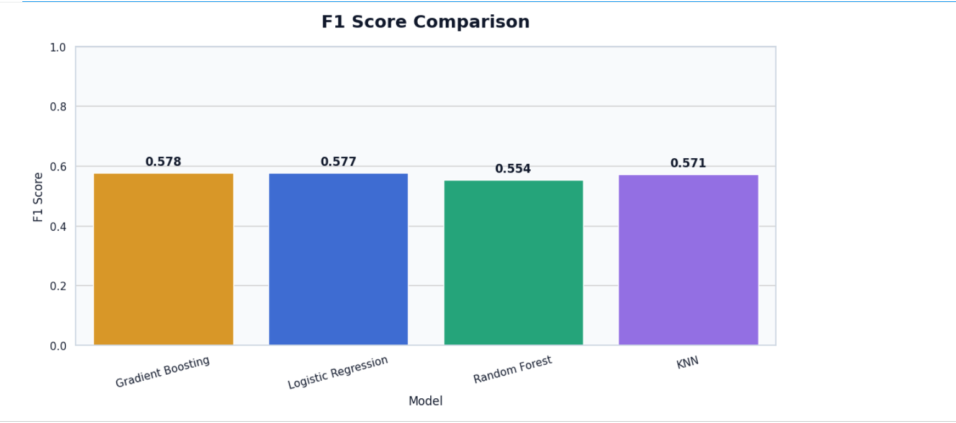
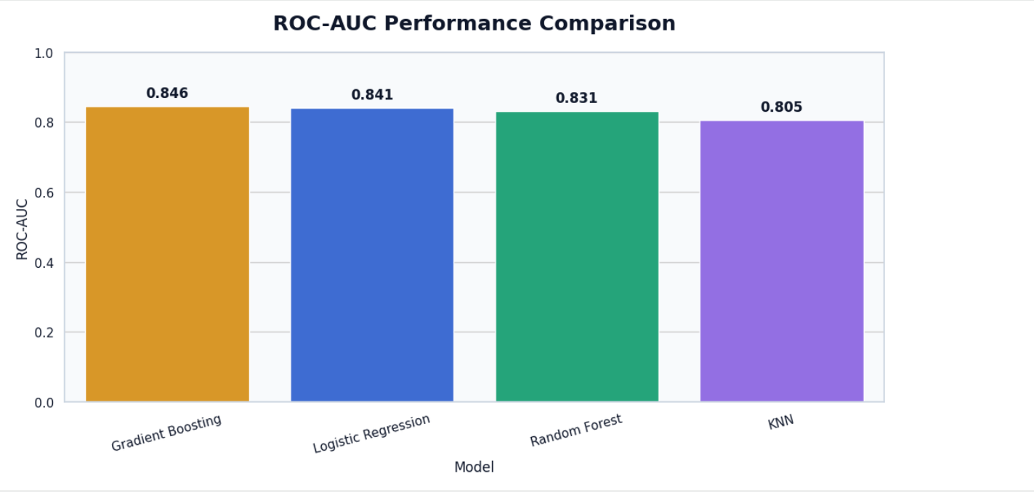
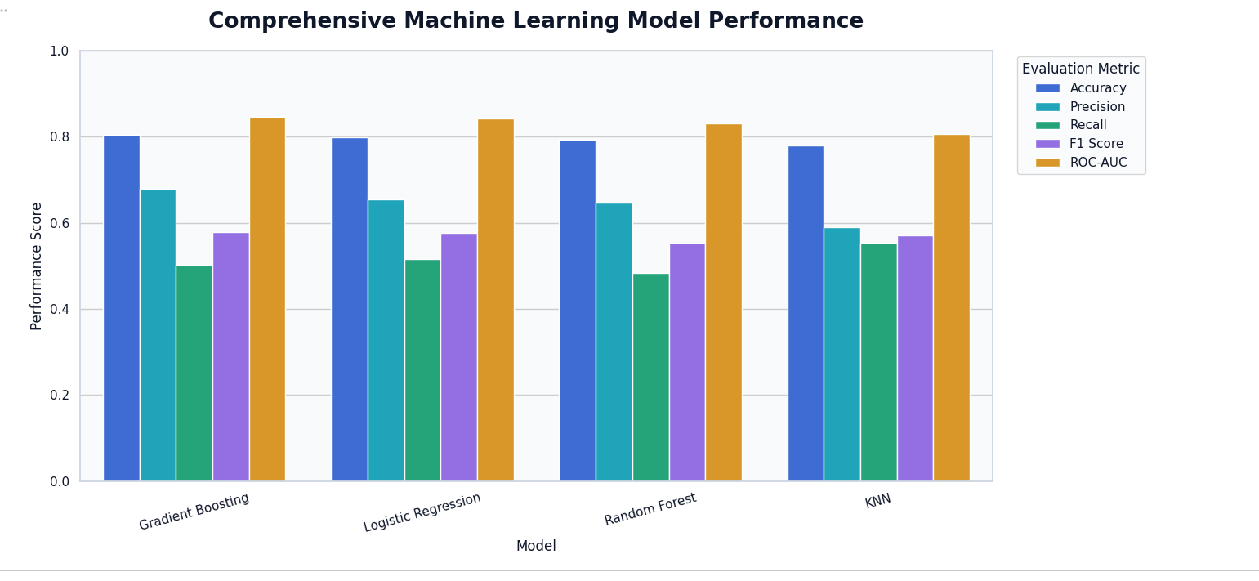
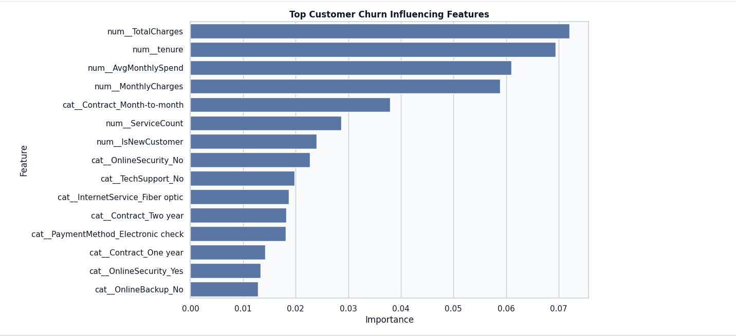
1. Machine Learning Model Accuracy Comparison
Compares the accuracy of all four models and identifies which model correctly classifies the highest percentage of customers.
2. F1-Score Comparison
Compares the F1-scores of the four models to identify the model that provides the best balance between precision and recall.
3. ROC-AUC Performance Comparison
Compares ROC-AUC values to show how effectively each model distinguishes between churn and non-churn customers.
4. Comprehensive Machine Learning Performance
Provides an overall comparison of Accuracy, Precision, Recall, F1-score, ROC-AUC, RMSE and R² across all four models.
5. Top Customer Churn Influencing Factors
Highlights the most important customer features contributing to churn prediction and helps identify the major drivers of customer attrition.

Slide 6
Model Building & Performance Comparison
MODELS | ACCURACY | PRECISION | RECALL | F1 SCORE | ROC-AUC | RMSE | R^2
Logistic Regression | 0.799148 | 0.654237 | 0.516043 | 0.576981 | 0.841125 | 0.372298 | 0.289130
KNN | 0779276 | 0.589744 | 0.553476 | 0.571034 | 0.805464 | 0.392533 | 0.209753
Random Forest | 0.792761 | 0.646429 | 0.483957 | 0.553517 | 0.830516 | 0.376647 | 0.272424
Gradient Boosting | 0.804826 | 0.678700 | 0.502674 | 0.577573 | 0.846347 | 0.367823 | 0.306114
Logistic Regression — baseline classification model
KNN — distance-based classification
Random Forest — ensemble decision-tree model
Gradient Boosting — advanced boosting model

Slide 7
Prediction & Streamlit Website
User input
User enters customer details
Trained best model generates churn prediction
Displays Churn Probability vs Stay Probability
Automatically categorizes Low / Medium / High Risk
Provides personalized Retention Recommendations
Displays customer analysis through an interactive Streamlit dashboard
Preprocessing
Best ML Model
Prediction
Probability
Risk Level
Risk Level

Slide 8
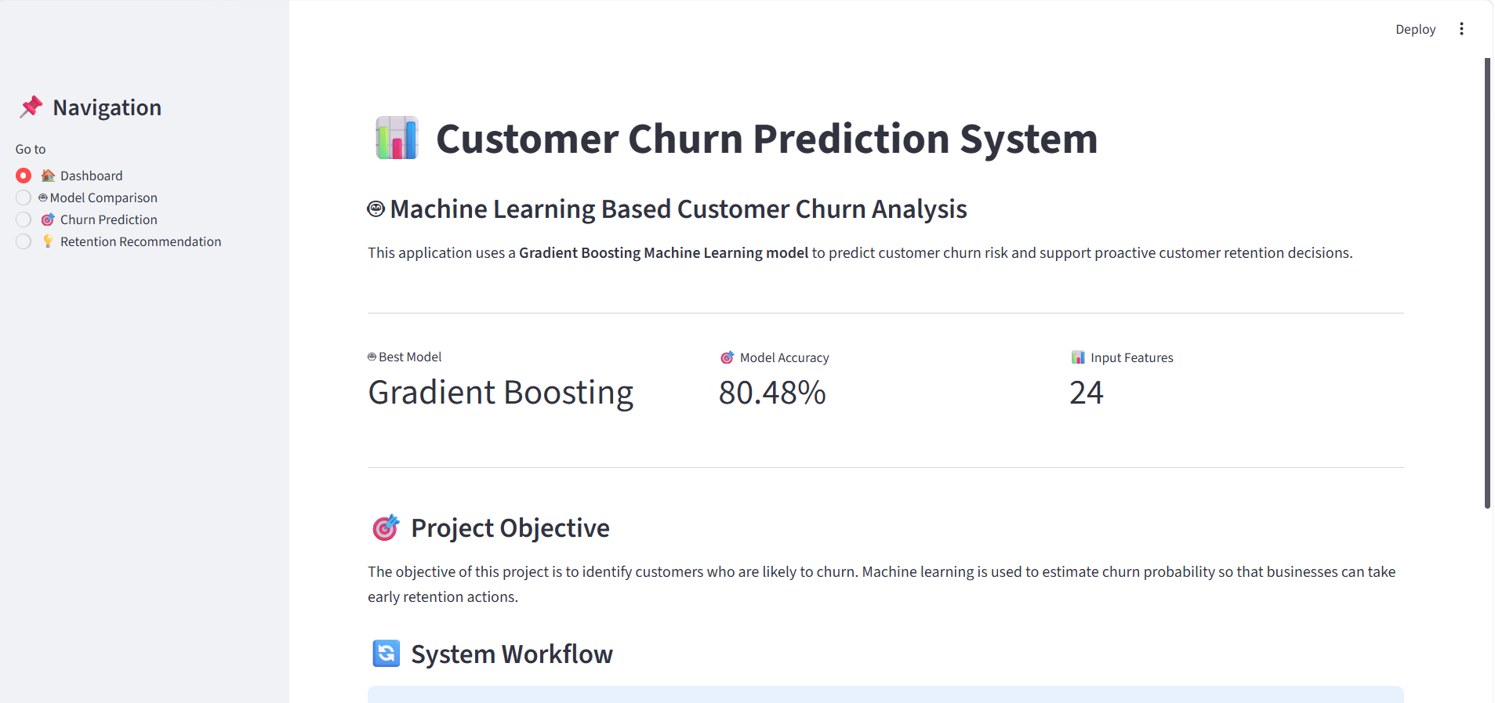
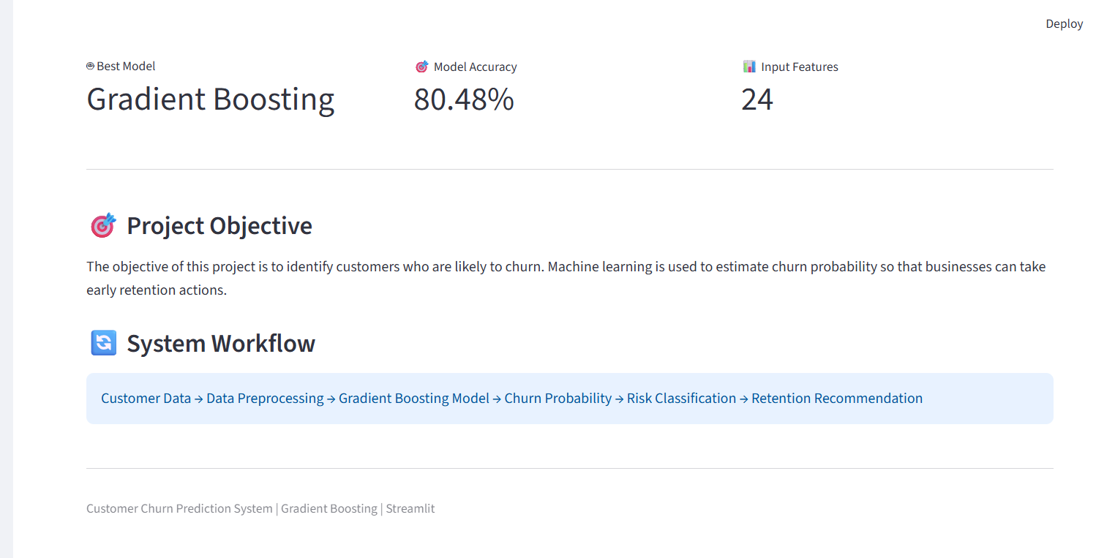
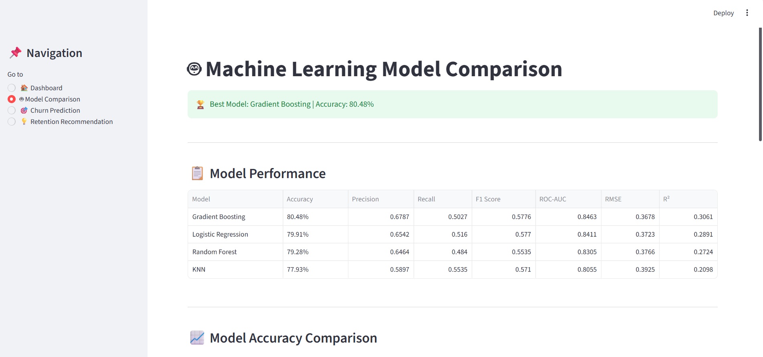
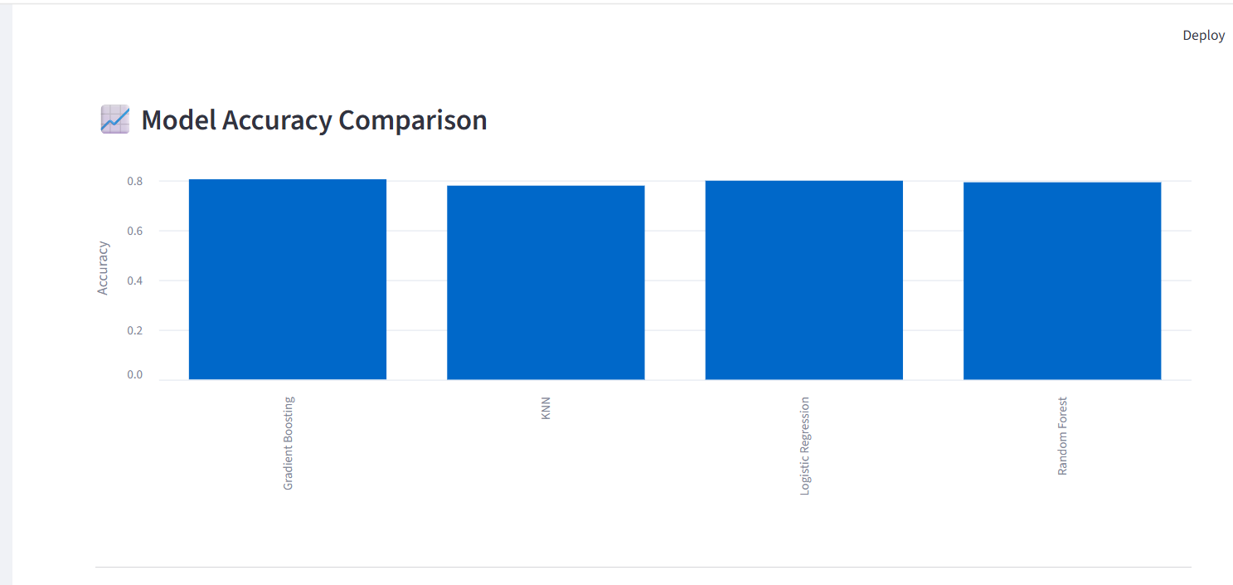
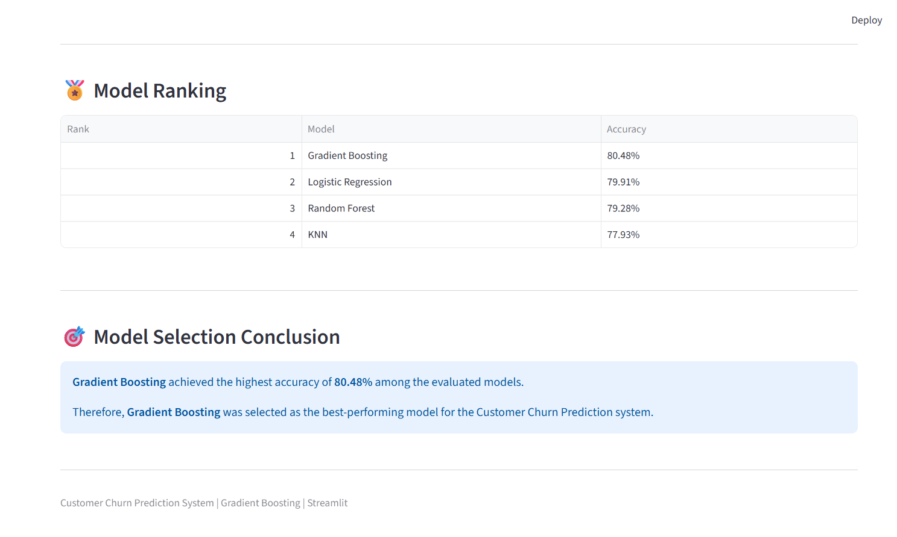
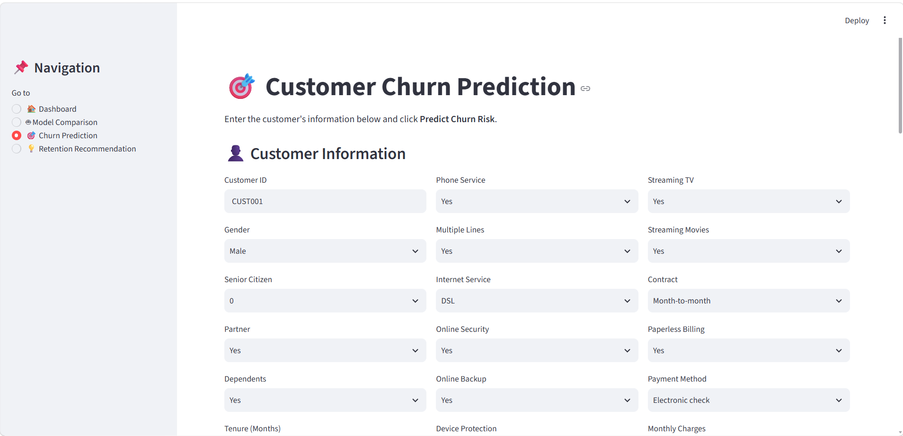
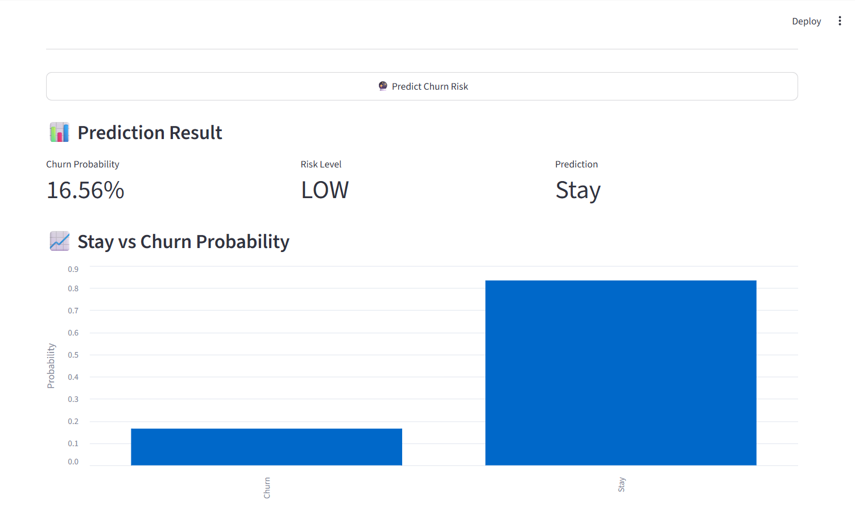
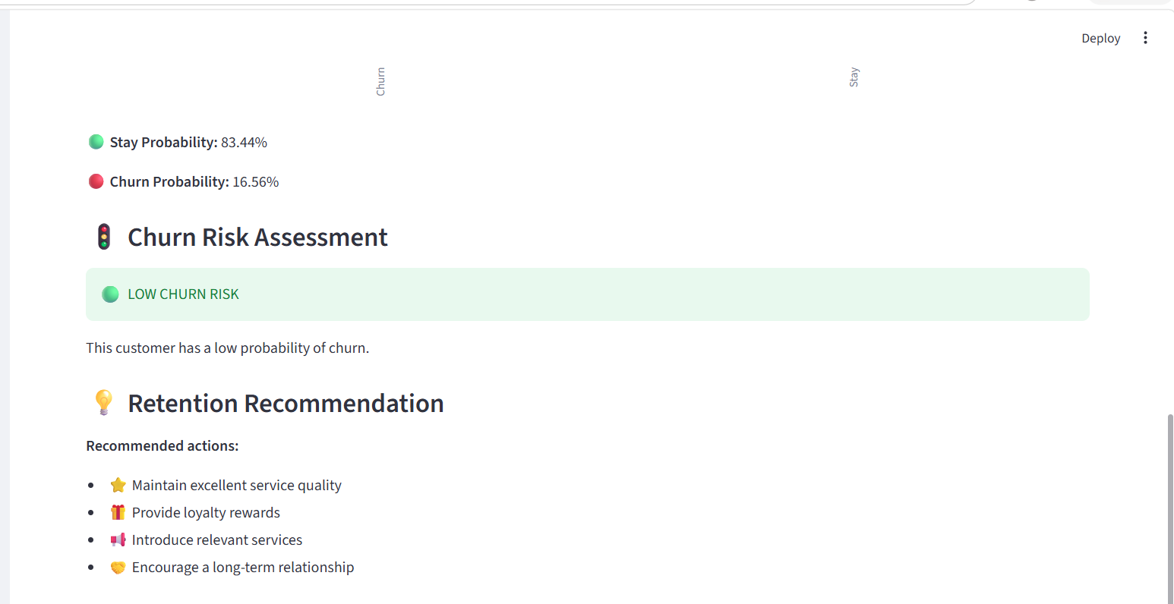
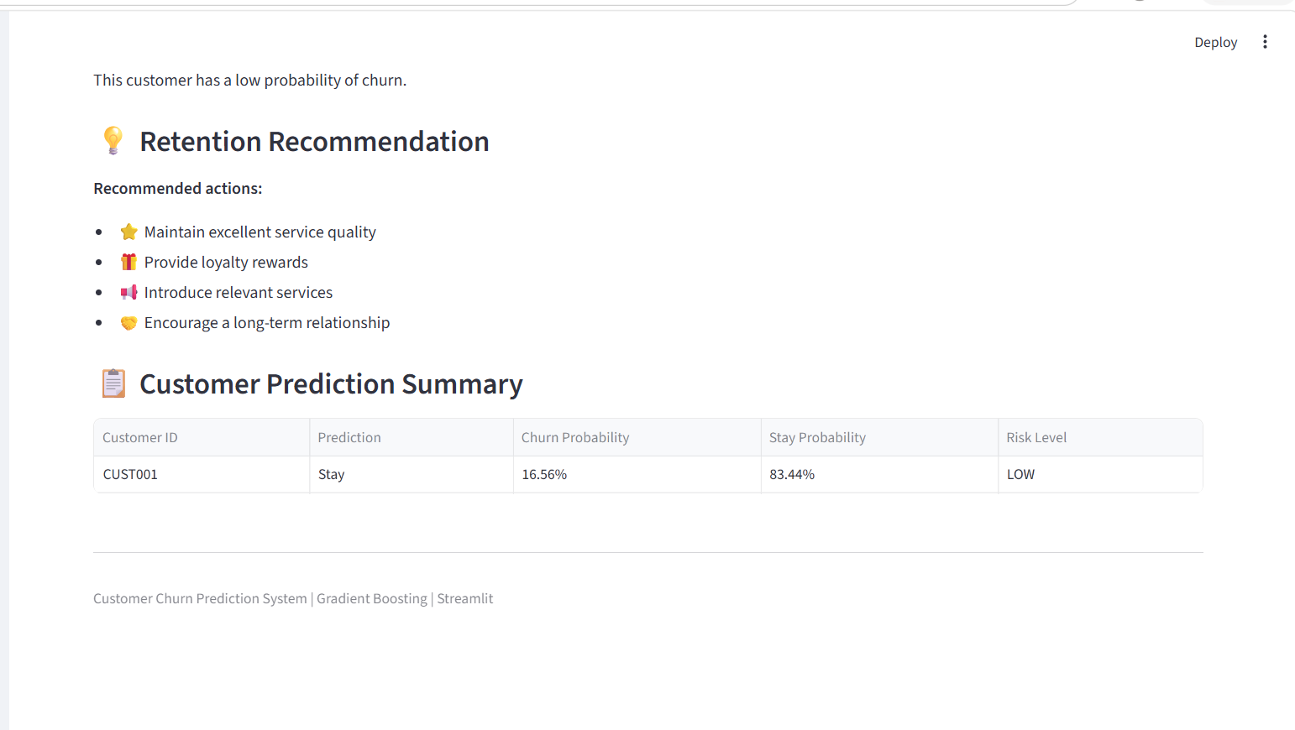
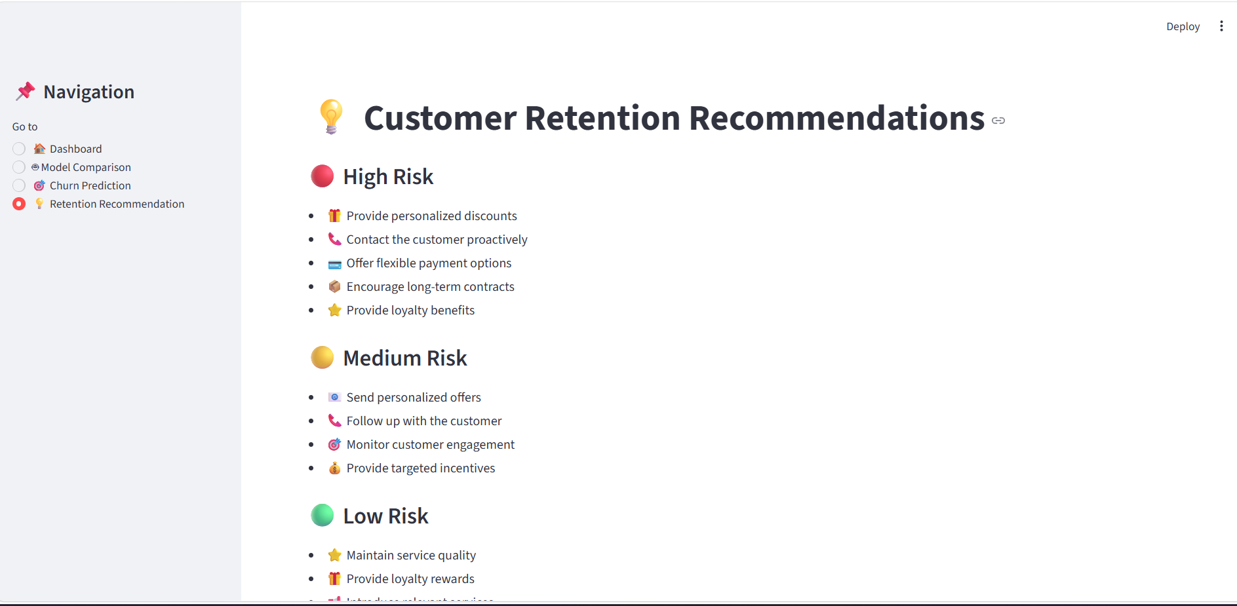
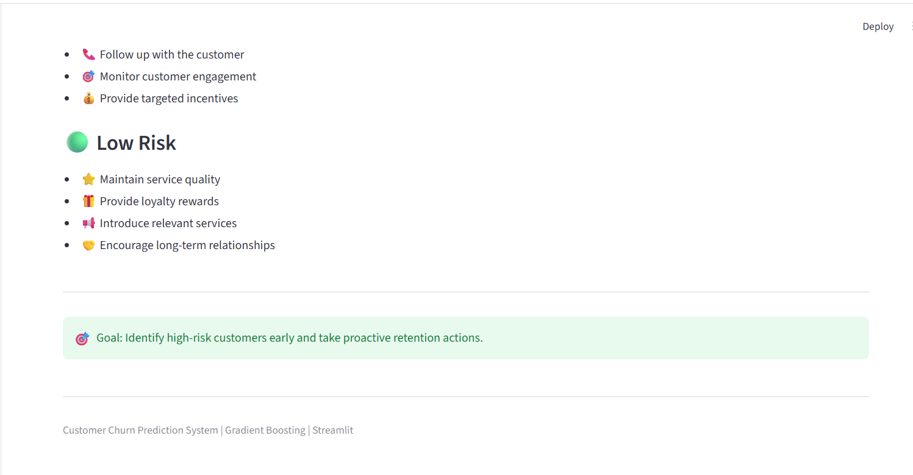

Slide 9
Results & Conclusion
Successfully trained and compared 4 ML models
Selected the best-performing model using evaluation metrics
Predicted customer churn probability for individual customers
Identified important factors contributing to churn
Developed an interactive ML-powered Streamlit application
Supports businesses in taking early customer retention actions

